Slide 1
The Foghorn Game Proposal
Chinmay Pai

Slide 2
Concept
Based on the creation and proliferation of fake news.
Play as the owner of a media corporation, from owning a small-town newspaper to a media empire spanning across print, TV and new media
Manage your important staff, including editors, TV presenters, and social media personalities.

Slide 3
Gameplay
News must be arranged onto the front page by the player, and is updated every half-hour.
Players must complete their front-page by 12 am.
These pages will help improve metrics such as sales, public outrage, and public adoration.
You may hire editors to spin articles in a certain way to have the desired effect on the public.

Slide 4
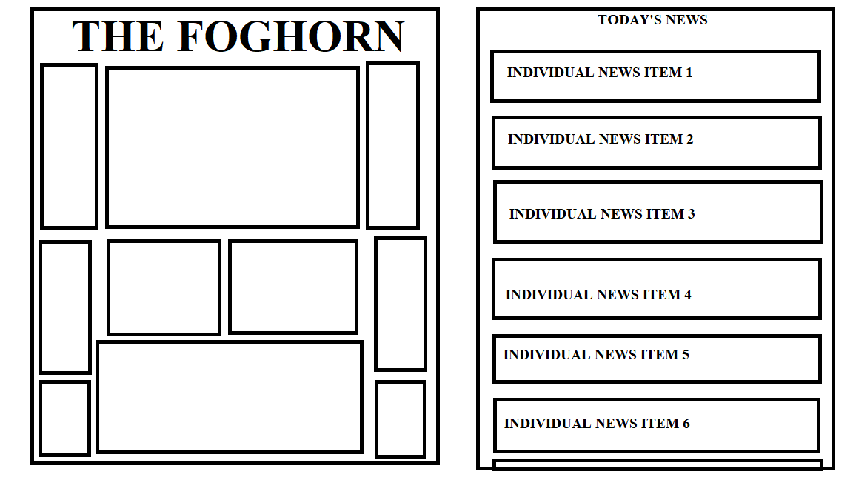
A basic image description of the gameplay system for newspapers. Individual news items (on the right) can be dragged to the position deemed appropriate, as new stories keep coming in every 30 minutes. Timers and other details are not shown.

Slide 5
Gameplay Advancement
Adding television and new media to the game, with associated new content and employees.
Managing Press Regulatory Agency requirements to ensure that they do not cause problems for you.
Random Events.

Slide 6
Aesthetic
Dark comic-book aesthetic, with story presented in panels
Attention to be paid to fonts

Slide 7
Presentation
Story of the rise of Keith William Murrow from small-town newspaper owner to media mogul.
References to real-life events.

Slide 8
Thank You

